Slide 1

Identifying Top Talent
Predicting a player’s talent and draft position using NFL Combine measurements, individual and team college data
Roland Herman 10/31/2020

Slide 2
Introduction
Datasets
Modeling approach
Deployment
Challenges
Conclusion

Slide 3
Introduction

Slide 4

Introduction
Problem Background
NFL – Billion-dollar industry, biggest league in the world by revenue
NFL Draft
Best opportunity for teams to improve
Young, inexpensive talent for years
Teams spend a lot to identify and select top talent
Draft is not an exact science
~ 11% of players selected never play a game
~ 50% of players selected never become primary starters
~ 35% of players selected don’t live up to expectations
~ $9M spent on contracts for unsuccessful draft class per team
Problem Statement
Notes:
As college football players prepare for the NFL combine at the start of the year, many rumors and speculations go around regarding who will be this year’s number 1 pick at the NFL draft. In the Draft, 224 selections are made over 7 rounds. In the lead-up to this event, the NFL holds the NFL Scouting Combine where players perform physical and mental tasks for NFL teams (e.g 40-yard dash, vertical jump, 3 cone drill), and personal interviews.
Problem statement:
- Data used for games played and primary starter calculations: https://www.pro-football-reference.com/years/yyyy/draft.htm (2000-2020)
- Unsuccesful players are defined based on their Approximate Value from Pro Football Reference and Expected Approximate Value: http://www.footballperspective.com/draft-value-chart/
- Money spent on contracts based on 2019 numbers: http://footballnextlevel.com/tag/2020-nfl-rookie-salary/
2019 – Avg Guaranteed Dollars for Draft Class: ~$22.9 Million
For Unsuccesful Draft Class: $9.2 M

Slide 5
Introduction
Modeling Approach
Focus: Offensive skill players
Questions
What are the key metrics to identify top prospects?
How can teams improve their ROI by selecting the right players?
Models to build
Binary classification (Top Talent)
Multiclass classification to predict draft round (1-3, 4-7, Undrafted)
Clients: NFL teams
Evaluate draft prospects and provide an unbiased grade
Give an estimate when a player might be selected
Notes:
Evaluate draft prospects and provide unbiased grade
NFL personnel departments could use the insights to help inform their decision making when deciding to draft an eligible collegiate player.
Give an estimate when a player get selected
Probability for each player of which round they would be selected. Results can be incorporated into team’s draft rankings and strategies (it can allow them to target a particular player or trade for a draft pick)

Slide 6
Datasets

Slide 7
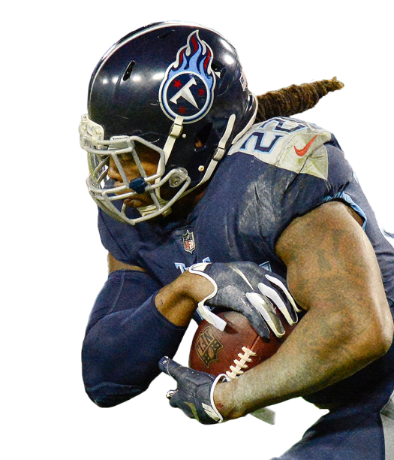



Data selection
21 years (2000-2020) of data scraped with Python from the following sources:
Sports-reference.com
Combine measurements
Draft classes
School offense and defense data
School ratings
Player college statistics
Nflcombineresults.com
Combine measurements (to check completeness)
Notes:
Challenges:
- Not to overload the website and get IP banned
- Imitate human behavior (increment random pauses, setting headers)
- Respect robots.txt
- Joining the data was challenging for individual statistics (separate page for every player)

Slide 8
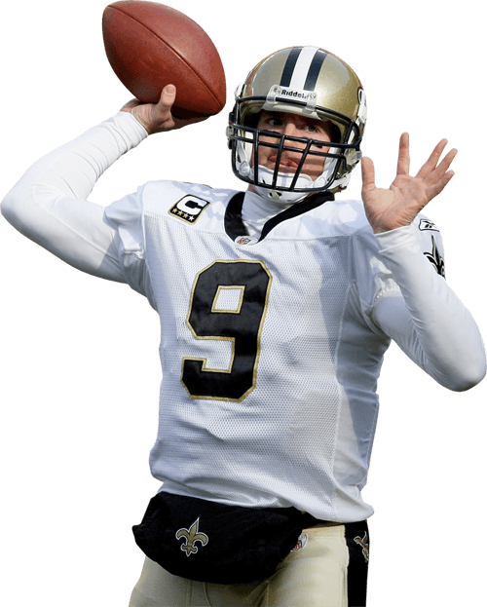
Data preparation
Data processing with Python & SQL
Data Cleaning
Remove special characters from columns (‘+’, ‘*’, ‘/’ etc.)
Remove non-numeric characters from numeric fields (‘1st’, ‘2nd’)
Handle missing values (case dependent)
Drop not relevant columns
Handle duplicates (very few -> manual corrections)
Uniformize school names, conferences, positions (e.g. Pittsburgh, Pitt)
Fix player links (manual) and extract player IDs from links
Convert columns to correct datatypes (numeric fields to integer/float)
Clean key columns to be able to join tables
Notes:
Handle missing values:
- No action: e.g. Not every player performed in every drill in the combine
- Fill with 0: e.g. Quarterbacks with missing receiving stats (its missing because its 0)
- Manually fill: when there are only a few cases (e.g. position, class)
- Impute median or KNN: e.g. to improve model performance median can be imputed for missing age, or knn for combine drills
Duplicates and player links: this is a manual process, not every player is referenced well in all tables, there are discrepancies

Slide 9
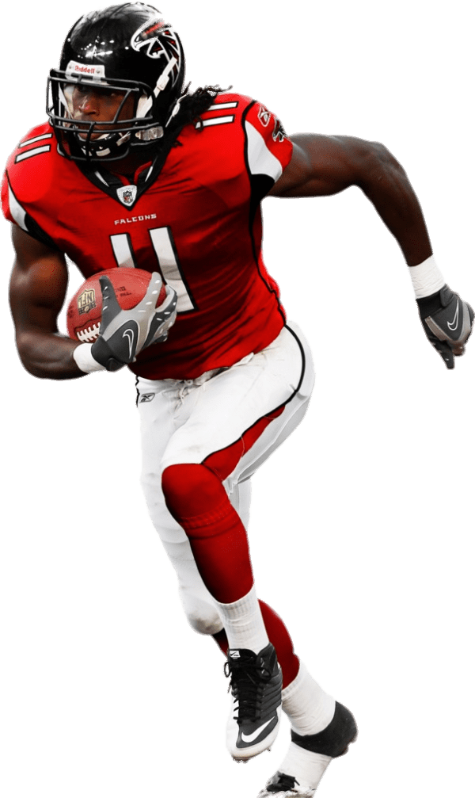
Data preparation
Data processing with Python & SQL
Joining Tables
Create indices on key columns to optimize queries
Join tables on key columns
Aggregate data to create 1 record / player
Handle arithmetic operations with zeros and NULLs
Round float values to 2 decimals
Create categorical columns (e.g. Position group)
Create binary columns (e.g. Power conference, Consensus All-American)
Handle players with drastic position change in college (e.g. Tannehill WR to QB)
Notes:
Categorical columns: for easier filtering and sorting
Handle players with position change in college
In football position changes can happen quite often (CB to Safety, OG to OT, etc.), but there are also a few cases of extreme position change. Ryan Tannehill for example transitioned from a WR to QB during his college years, which creates noisy data and affects his per game statistics as well. To prevent this, I manually went through players with positional changes and removed the irrelevant rows (for Tannehill I deleted his 2 years as a WR).

Slide 10
Modeling approach

Slide 11
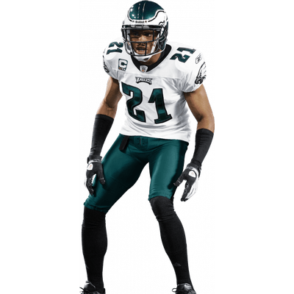
Modeling approach
Experimental Methodology
Models to build:
Binary classification to identify top talent
Target: Top Talent (1,0)
Optimization metric: LogLoss (probability matters)
Partitioning: Stratified
Multiclass classification to predict draft round
Target: Rounds 1-3, Rounds 4-7, Undrafted
Optimization metric: LogLoss (probability matters)
Input data:
College player data - per game statistics
Combine measurements, Draft classes
School offensive and defensive statistics, School ratings
Notes:
Definition of Top Talent: selected in the 1-3 rounds of the draft
Raw totals vs raw per game
Raw totals can be deceiving, because not every player played the same number of games, so per game stats is a better was to measure performance.
I also split the data into:
- most recent year’s performance
- prior career performance (weighted average)
Optimization metric
Imbalanced data - LogLoss is a good choice for these scenarios because they penalize predictions based on how far away they are from reality. So when the predicted probability of a case from the positive class is very low, that error is going to be proportionally increased. The more wrong the prediction the higher the error.
Partitioning
Stratified because of imbalanced data: rows are assigned in a way that ensures similar target distribution across each partition.

Slide 12
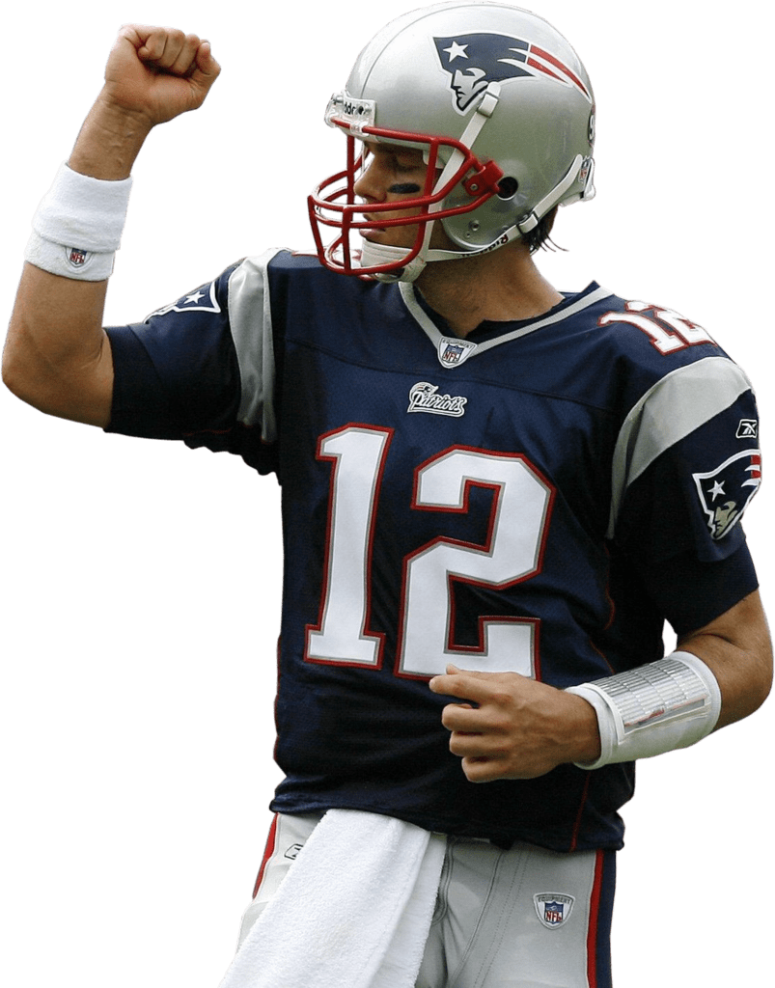
Modeling approach
Engineered Features
Body Mass Index (BMI) – lean muscle mass for athletes
Speed Score – weight adjusted 40 yard dash score
Height Adjusted Speed Score (HASS)
Vertical Jump Power – weight adjusted vertical jump score
Broad Jump Power – weight adjusted broad jump score
QUIX Score – weight adjusted 30 yard shuttle & 3 cone drill score
Expected Bench Reps – height & weight adjusted Bench press
College Dominator Rating – player’s share of offensive production
Notes:
There are many debates and criticism about the importance and weight of combine drills. In my opinion, measurements taken in isolation can’t define athleticism or predict success. However, there are advanced metrics that captures better how a player performed in the Combine.
Speed score
- Weight adjusted 40 yard dash score, rewards heavier players
- https://www.footballoutsiders.com/stat-analysis/2018/speed-score-2018
Height Adjusted Speed Score
rewards taller players
http://moneyinthebananastand.com/2012/04/24/dominator-rating-height-adjusted-speed-score-and-wr-draft-rankings/
Vertical Jump Power - Sayers Power Formula
measures lower body force generation, rewards heavier players
https://www.topendsports.com/testing/vertical-jump-power.htm
Broad Adjusted Jump Power – Sayers Power Formula
Same as vertical jump power
QUIX Score
Weight adjusted 30 yard shuttle and 3 cone drill score, measures speed with changing directions, rewards heavier players
https://www.milehighreport.com/2016/3/8/11160328/2016-nfl-draft-top-10-quix-score
Expected Bench Reps
Weight and Height Adjusted Bench Reps to calculate performance (actual – expected)
http://www.footballperspective.com/alex-barnes-was-the-2019-combine-bench-press-champion/#more-41629
College Dominator Rating
The college dominator rating represents a player’s “market share” or his percentage of his team’s offensive production. For example, a 35+% dominator indicates that a wide receiver has the potential to be a team’s No. 1 WR and/or a high caliber contributor. 20-35% indicates a mid-level talent with situational upside. Less than 20% is a red flag. For wide receivers and tight ends, the dominator rating is the percentage of team receiving production. For running backs, it is the percentage of total offensive production, because running backs are involved in both the running and passing game.
https://www.playerprofiler.com/terms-glossary/

Slide 13
Modeling approach
Exploratory Data Analysis
Identified Target Leakage
By DataRobot: Draft Round, Draft Round Category, Draft Pick, Expected AV
By me: Draft Team, Draft Age, Approximate Value, Success
Non-Informative Features
By DataRobot: Player ID, Player Name
By me: Draft Year (can also falsely have predictive power due to removed players with missing data)
Data Quality Assessment
Outliers, Missing values, Excess zeros – checked, OK
Feature List
Categorical: School, Conference, Class, Position etc.
Numeric: Combine performance, Engineered Features, College statistics, etc.
Notes:
Top Talent Definition: selected in rounds 1-3 in the Draft
Target Leakage
By DataRobot: makes sense, all features are closely connected to/calculated from to draft rounds and unknown at the time of prediction
By me: Team, Age, AV, Success all missing if player was not drafted and unknown at the time of prediction
Data Quality Assessment: I checked every feature and didn’t identify any issues.

Slide 14
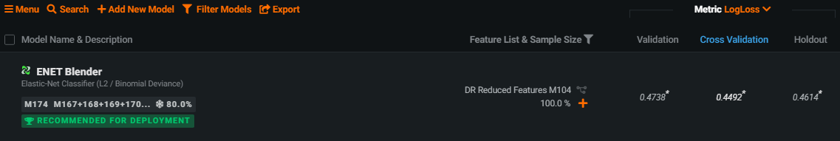
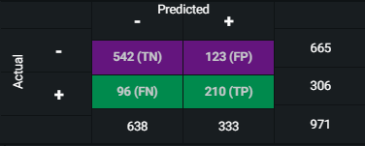
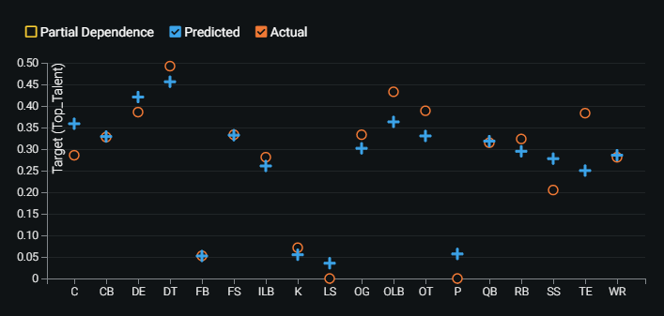
Modeling
Binary classification – Initial results
Top performing model: ENET Blender with 0.4738 LogLoss
Notes:
The initial model’s performance is not bad but looking at different charts and metrics (confusion matrix, feature fit) there is room for improvement.

Slide 15
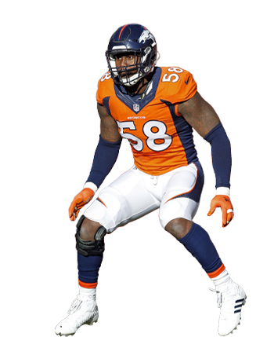
Modeling
Attempts to Improve Model Performance
Normalization
Why is it needed?
Style of football has changed over time
Differences in style among college teams
Parameters
Passing and receiving statistics to 30 team pass attempts per game
Rushing statistics to 35 team rush attempts per game
Tackles and fumbles to 65 opponent offensive plays
Sacks, interceptions, and passes defended to 30 opponent pass attempts
Notes:
Data has changed the style of football over time: traditionally being a rush heavy game, today relies more on passing. College teams styles greatly vary depending on their coaching staff and talent. With normalization we can eliminate differences between pace and style and put data in context.

Slide 16
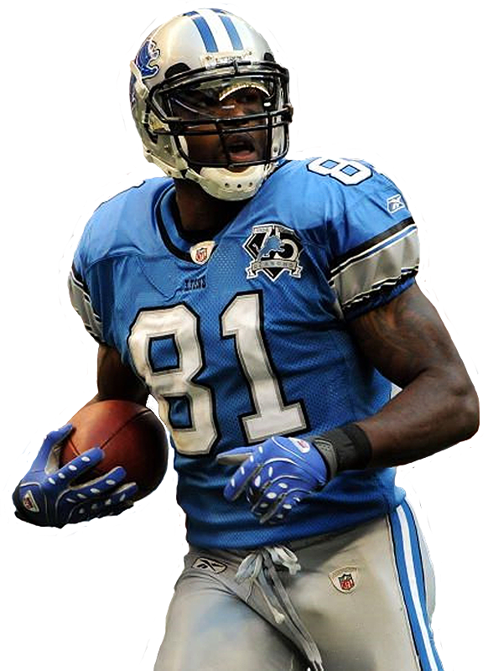
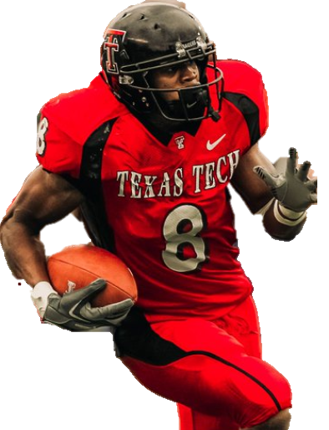
Normalization Example (Wide Receiver)
Joel Filani
13 Games
Are they both top talents?
Calvin Johnson
14 Games
Raw Per Game 06/07
7.0
Catches
5.4
100.0
Yards
85.9
1.0
TDs
1.1
Normalized Per Game 06/07
4.2
Catches
6.2
59.5
Yards
97.6
0.6
TDs
1.2
Notes:
The 2 players put up similar overall numbers, but while Filani did it in an air raid style offense that relied heavily on passing, Johnson played on a more balanced offense.
This example shows that raw statistics can be deceiving, but with normalization we can put data into context and make it more informative. It can have a significant effect on the predictive power of the model.

Slide 17
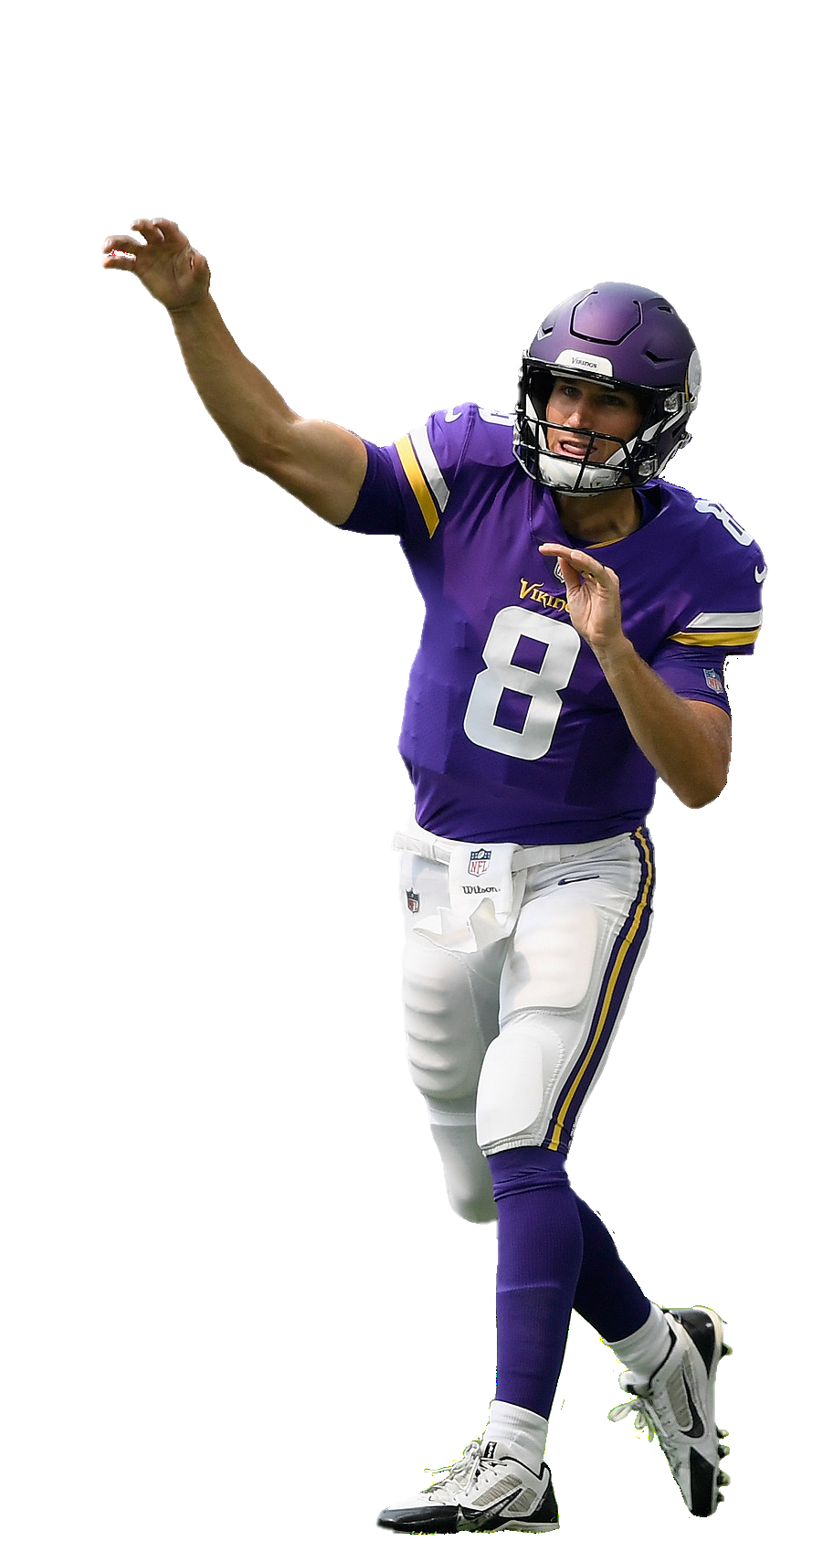

Modeling
Further Attempts to Improve Model Performance
Remove special team players: kickers, punters, long snappers
Remove fullbacks due to small sample size
Remove players who lack individual stats (e.g. offensive linemen)
Build separate models for offense and defense
Remove irrelevant individual stats (e.g. def tackles for off players)
Handle players with drastic position change (e.g. Tannehill WR to QB)
Impute missing combine measurements (k nearest neighbor)
Impute missing draft age (median)
Notes:
Special Teams (K, P, LS):
Looking at the feature fit by position I noticed that the model struggles a bit with special team players. It makes sense because of the extreme specialization that each position requires. The sample sizes are also small for these positions. I have decided to remove kickers, punters, long snappers.
Fullbacks:
Fullback is a highly specialized, also a dying position with a small sample size, so I ended up removing it from the model.
Offensive linemen (C, OG, OT):
Also based on the feature fit I realized the model is struggling with offensive linemen. The reason is probably that they lack individual statistics, so its hard to evaluate them. I have decided exclude them from my model.
Not every player performs every test at the NFL combine, so I used mice to impute the missing combine scores. This allows me to ignore missingness in these variables (which may be informative!) while doing machine learning. You can see how I prepare the data in the source files.
For the college statistics, I only use count statistics (e.g. number of tackles, number of interceptions) so you can interpret a zero as the player did not do this in college. It’s not perfect, since we are missing college data for a number of players and they will look the same as players who didn’t accumulate any statistics.
off good data prep skills (data cleaning, joining, . . .)? ● Was this a unique project?
It doesn't make sense to include tackles for offensive players, nor rushing yards for defensive players. It's best to remove these entirely so that the model can focus on meaningful splits.

Slide 18
Model evaluation Top Talent - Binary Classification

Slide 19
Modeling
Model results
Model performance (same random seed where applicable)
Model | LogLoss | Baseline LogLoss (35% prevalence)
Raw per game | 0.4738 | ~0.65
Normalized per game | 0.4667
Normalized - irrelevant stats removed | 0.4750
Normalized - special positions removed | 0.4515
Normalized Offense | 0.3788
Normalized Defense | 0.5172
Notes:
Baseline LogLoss
https://stats.stackexchange.com/questions/276067/whats-considered-a-good-log-loss

Slide 20
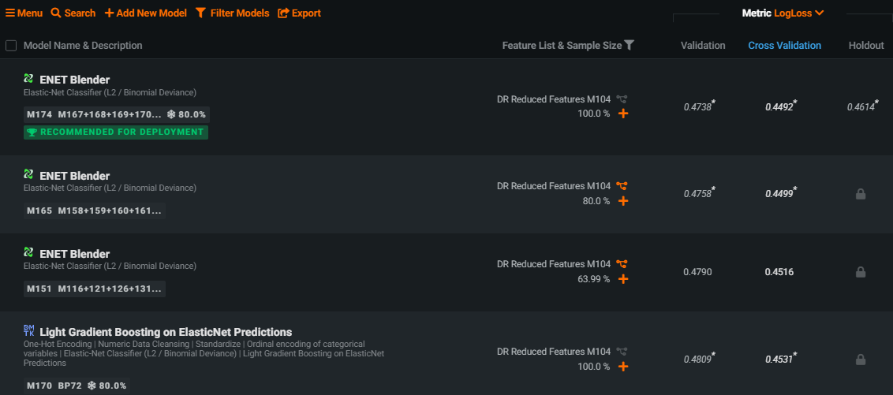
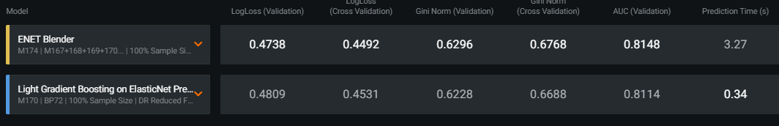
Modeling
Leaderboard and Blueprint
Top performing model
ENET Blender (LogLoss of 0.4738)
Top non-blender: Light Gradient Boosting on ElasticNet Predictions (0.4809)
Blender model performs consistently better, but makes predictions slower (that’s ok, player evaluation is not very time sensitive)
Data preprocessing
Impute missing numeric values and standardize
One-hot and ordinal encoding of categorical variables
Elastic-net classifier with L1 and L2 regularization
Notes:
Feature effects
Analyzing individual features and the effect they have on the tendency to call run or pass plays can be very insightful. Sometimes feature effects, which uses partial dependence (PD) to measure, can either reinforce your intuition or call it into question. A partial dependence plot illustrates the marginal effect that a given feature has on the predicted value. A partial dependence plot can show whether the relationship between the target and a feature is linear, monotonous or more complex. I took a look at the top handful of features to do a deeper dive.

Slide 21
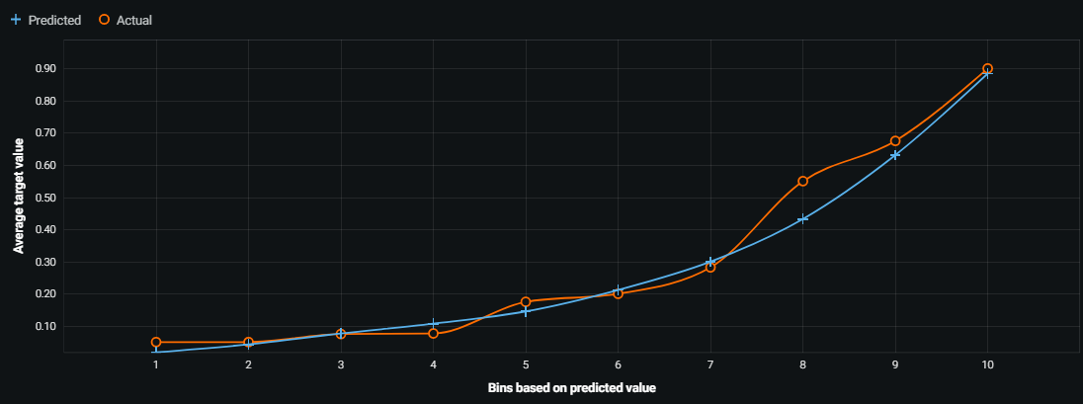
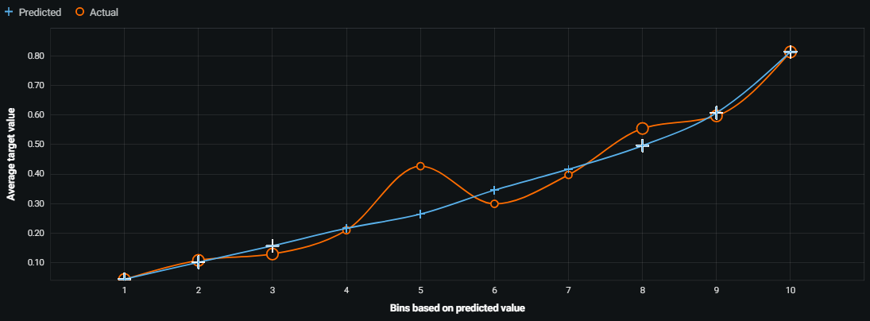
Modeling
Lift Chart for Holdout
Offense
Defense
Model able to differentiate low and high performers
Very accurate predicting top talent
Model able to differentiate low and high performers
Less accurate than offensive model: - Defensive performance is high variance - Data is less detailed
Notes:
Lift chart
Football is full of variance, especially defensive performance. The model did a good job predicting offensive performance, while struggling a bit with defenses.

Slide 22
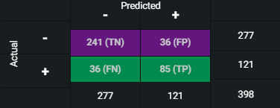
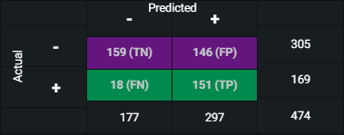
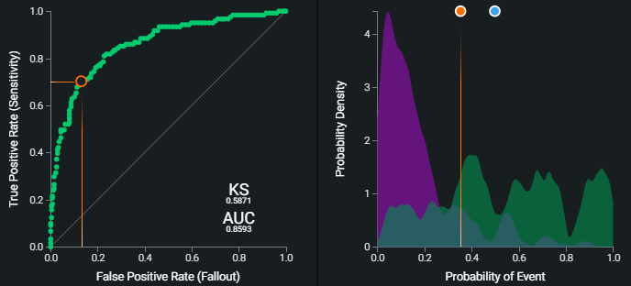
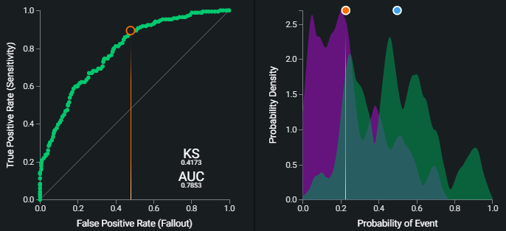
Modeling
Confusion Matrix, ROC Curve, Prediction Distribution
Offense – 82% Accuracy (max F1 score)
Defense – 65% Accuracy (max F1 score)
Notes:
Confusion matrix
- Quite many TP
- True Positive: Correctly identifying top talent
- False Positive: Wrongfully identifying player as top talent
- True Negative: Correctly identifying player as not top talent
- False Negative: Wrongfully identifying player as not top talent
ROC curve and prediction distribution analysis
The ROC (Receiver Operating Characteristic) curve and the prediction distribution help analyze model performance, robustness, and set thresholds to choose if the player is a top prospect. The green distribution (right) represents top talents, while the orange line is the optimal threshold, chosen to maximize the balance between precision and recall (F1 Score). The overlap in distributions is more significant for defenses, which means, at times, it will be difficult to make predictions.

Slide 23
Modeling
Profit Curve
Question In the context of the NFL teams, what is the cost of true/false positives and negatives?
Measuring the financial contribution of a top player is complex
Ticket sales, Merchandise, Revenue from on-field performance, TV deals
If I were in charge:
 | Player A | Player B
Projection | Superstar Ability | Potential Starter
Success Probability | 40% | 75%
A false positive is better than a false negative: I wouldn’t want to miss on top talent
It’s worth taking some risks: selecting a future superstar can change the franchise for years
Top player’s contribution > starter’s contribution > negative impact of a bust
Notes:
Profit Curve:
- True Positive: Correctly identifying top talent
- False Positive: Wrongfully identifying player as top talent
- True Negative: Correctly identifying player as not top talent
- False Negative: Wrongfully identifying player as not top talent
Example: My personal choice is Player A

Slide 24
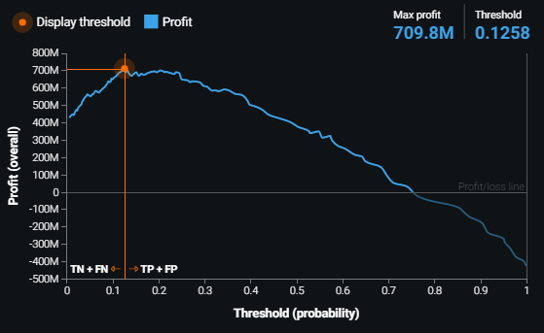
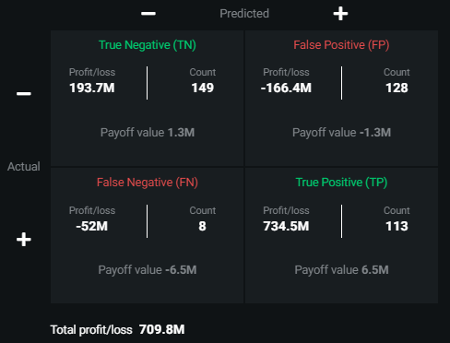
Modeling
Profit Curve - Offense screenshots
Conclusion:
Lower threshold, number of TP and FP goes up, number of TN and FN goes down
Approximate profit per team per draft class: $13 Million
Notes:
Profit Curve:
- True Positive: Correctly identifying top talent
- False Positive: Wrongfully identifying player as top talent
- True Negative: Correctly identifying player as not top talent
- False Negative: Wrongfully identifying player as not top talent
Values for the profit matrix
Based on the last side let’s say when the model correctly identifies top talent the NFL team gets $6.5 revenue per draft class. When our model incorrectly classifies a negative case as positive, the organization loses $1.3 million. A true negative saves the team $1.3 million, while a false negative results in a $6.5 million loss.
Conclusion
Lower threshold
Number of TP and FP increased
Number of TN and FN decreased
Total profit: $709.8 M for Offense, $881.4 M for Defense = $1591.2 M, 872 Players total
Profit for 1 player: $1.82 M, Profit for a Draft class: $12.77 M

Slide 25
Modeling
Feature Impact
Offense | Defense
HASS, Class, 40 Yd Dash, Dominator Rating, School, Pass Completions, Scrimmage Yds | Speed Score, Class, Consensus AA, HASS, 40 Yd Dash, Weight, Tackles For Loss
Conclusion
Speed is king: Absolute speed and relative speed to weight and height both crucial
Size matters: Do bigger players have more success in the NFL?
Class (Age) makes a difference: Are underclassmen selected earlier?
College program is key: Do top football programs dominate the Draft?
Offensive production is vital for offense: Dominator Rating, Pass Completions, Scrimmage Yards
Consensus honor: impactful indicator of talent for defense
Notes:
Conclusion
Speed is king: 40 yd dash is the most important test in the Combine. It can determine whether an athlete has a career as a football player. https://simplifaster.com/articles/nfl-speed/
Size: General belief in the NFL that size matters. Most players are big and strong, however, there are a few smaller players who have succeeded (e.g. Drew Brees 6’0).
Class: The younger age a player can dominate at college level, the earlier he can adjust to the NFL and contribute
School: There are some top programs in college football with extraordinary success, who can really differentiate themselves from the rest. Being a known winner naturally draws top talent to their programs.

Slide 26
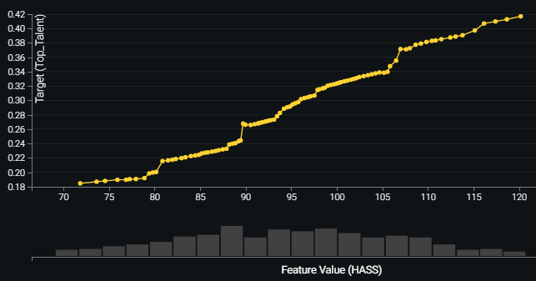
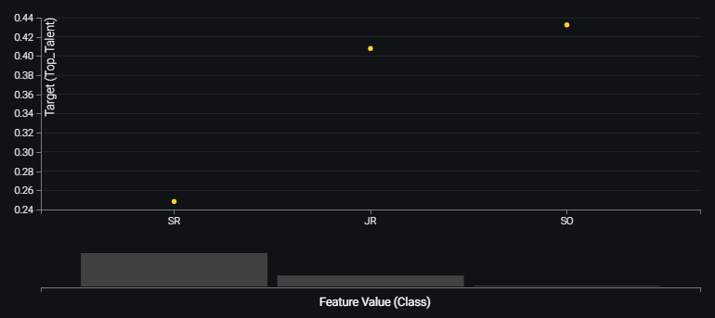
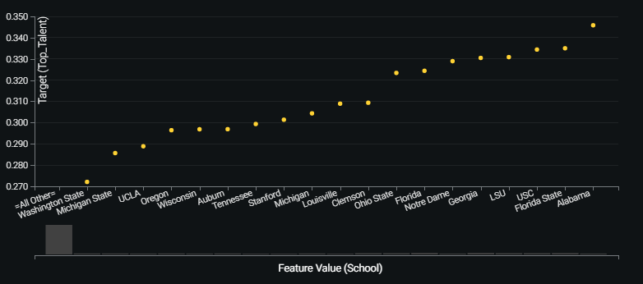
Modeling
Feature Effects
HASS
Class
College
Athleticism is key: Faster players (relative to height and weight) have a better probability to get selected early
Most players in the Combine are seniors
Sophomores and Juniors are more likely to be selected in the early rounds
Prospects from top programs (Alabama, USC, etc.) have a better chance to be picked in rounds 1-3
Notes:
Feature effects
I took a look at the top features in the Feature Effects. The results make sense and confirmed my hypothesizes regarding athleticism

Slide 27
Modeling
Predictions – Cherry-Picked Examples
Model outperformed NFL teams – Prediction threshold: 0.1258 (Max Profit)
Player | Pos | Draft Pick | NFL Career | Top Talent Odds
Drew Stanton | QB | 2 (43) | Never became primary starter | 8.5%
Kenny Irons | RB | 2 (49) | Never played a game in the NFL | 12.5%
Jason Peters | OT | Undrafted | 9x Pro Bowl, 2x All-Pro, SB Winner | 49.5%
Model fell behind
Player | Pos | Draft | NFL Career | Top Talent Odds
Drew Brees | QB | 2 (32) | Future Hall of Famer | 12.4%
Darren Sproles | RB | 4 (130) | 8x Pro Bowl, 2x All-Pro, SB Winner | 5.5%
Tyree Jackson | QB | Undrafted | Never played a game in the NFL | 68.9%

Slide 28
Model evaluation Draft Position - Multiclass Classification

Slide 29
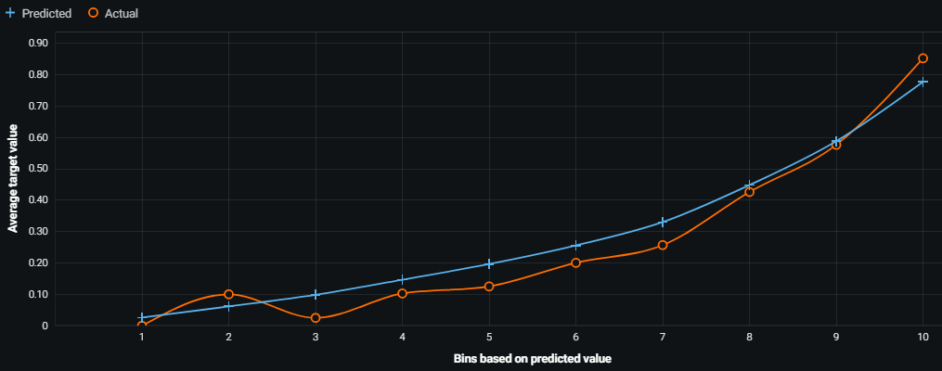
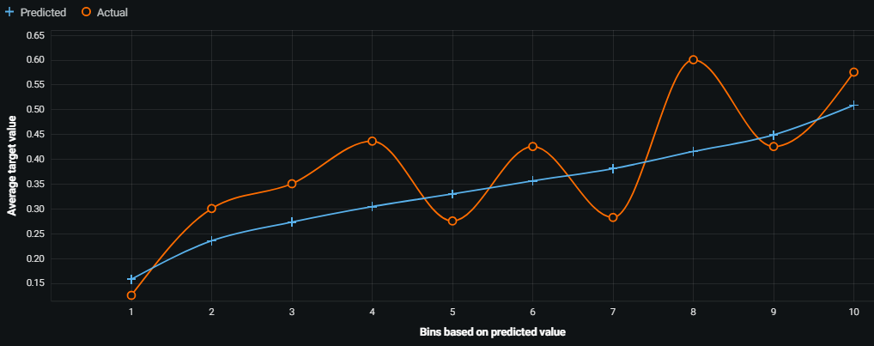
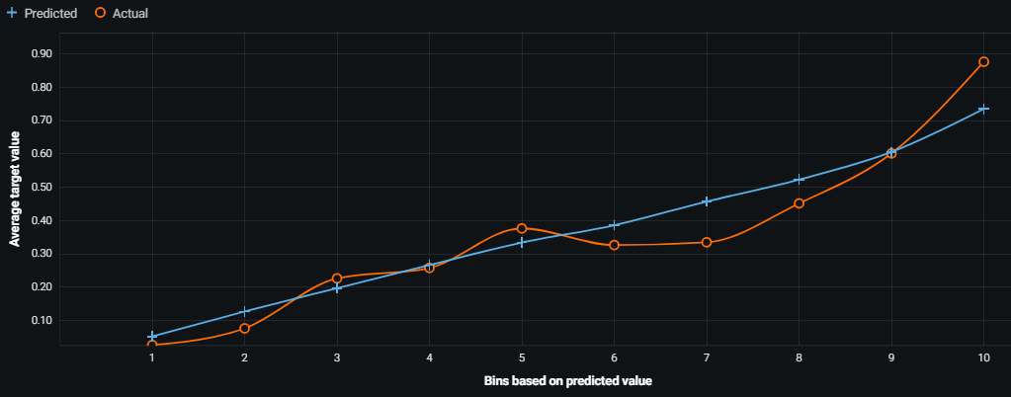
Modeling
Lift Chart for Holdout - Offense
Rounds 1-3
Rounds 4-7
Undrafted
Top performing model: ENET Blender with 0.8300 LogLoss (Baseline LogLoss: 1.1)
Model is quite accurate predicting early round picks and undrafted players
Model struggles with mid-late round selections:
Players drafted in round 4-5 might have similar values as round 3 selections
Players selected in rounds 6-7 are not so different than undrafted players
Conclusion: team fit and position needs play a bigger role in mid-late rounds
Notes:
Lift chart
The model did a good job predicting early round picks and undrafted players, while struggling with mid-late round selections. It makes sense, as in later rounds team fit and team needs play a bigger part in the draft. Model could be improved with additional data (scouting reports for personality traits, contract information, positional needs for teams, etc.).
Baseline LogLoss
https://stats.stackexchange.com/questions/276067/whats-considered-a-good-log-loss

Slide 30
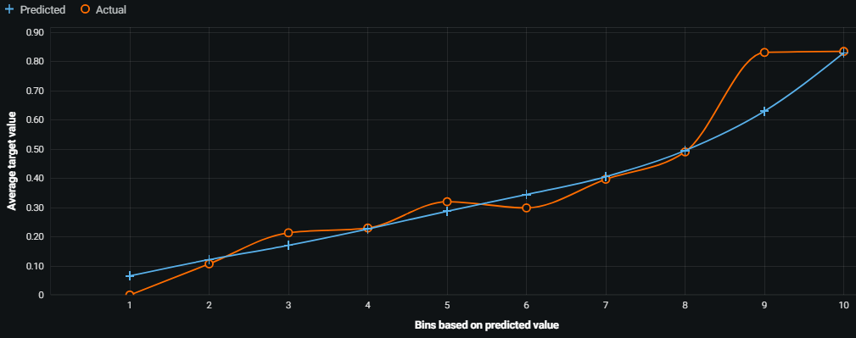
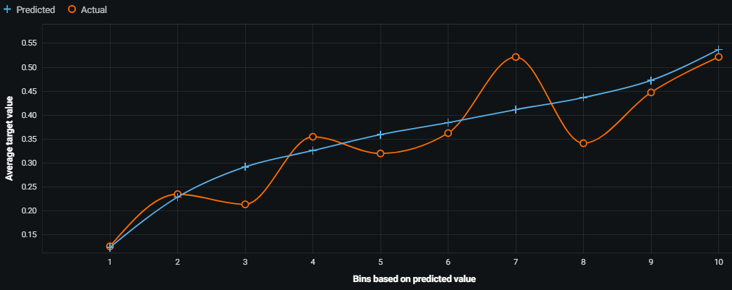
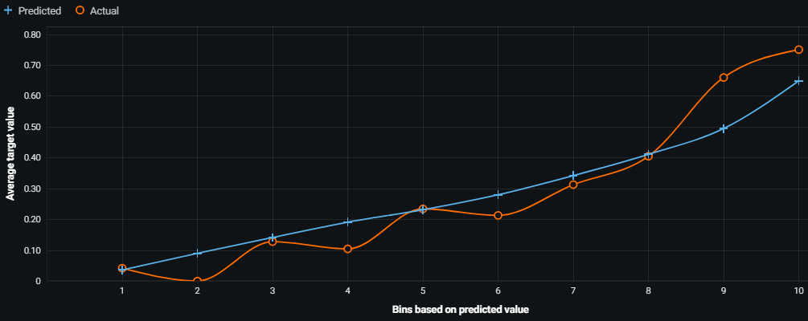
Modeling
Lift Chart for Holdout - Defense
Rounds 1-3
Rounds 4-7
Undrafted
Top performing model: ENET Blender with 0.9381 LogLoss (Baseline Logloss: 1.1)
Similar results as offense model:
Good accuracy predicting early round picks, fairly accuracy with undrafted players
Poor accuracy with mid-late round selections
Notes:
Baseline LogLoss
https://stats.stackexchange.com/questions/276067/whats-considered-a-good-log-loss

Slide 31
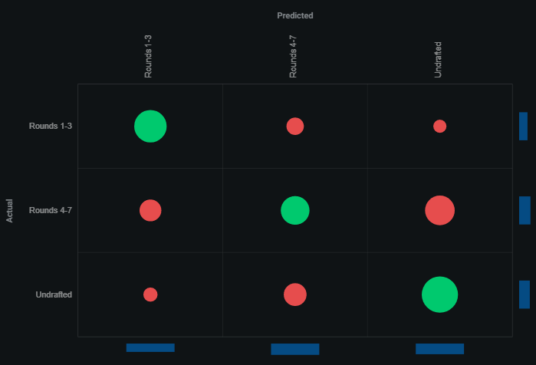
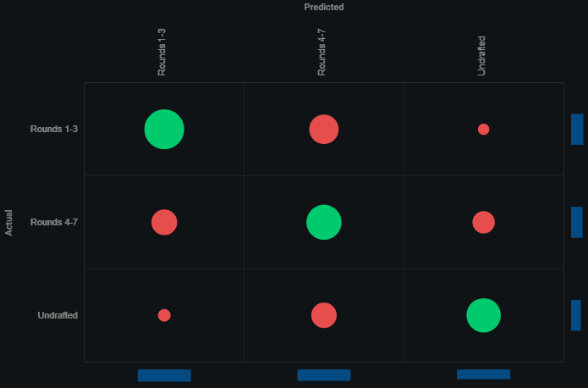
Modeling
Confusion Matrix
Offense
Defense
Round | F1 | Recall | Precision
1-3 | 0.65 | 0.69 | 0.61
4-7 | 0.43 | 0.38 | 0.50
Undrafted | 0.60 | 0.65 | 0.55
Round | F1 | Recall | Precision
1-3 | 0.64 | 0.61 | 0.66
4-7 | 0.48 | 0.52 | 0.45
Undrafted | 0.62 | 0.59 | 0.65
Notes:
Confusion matrix
As expected based on the lift chart, the model differentiates 1-3 round and undrafted players quite well with generally better accuracy than 4-7 rounds. The model most confuses:
1-3 rounds with 4-7 rounds
4-7 rounds with 1-3 rounds (also significant confusion with undrafted players)
Undrafted players with 4-7 rounds

Slide 32
Modeling
Predictions – Cherry-Picked Examples
Model outperformed NFL teams
Player | Pos | Draft Pick | NFL Career | Prediction
Vernand Morency | RB | 3 (73) | Never became primary starter | Undrafted (49.4%)
Sean Mannion | QB | 3 (89) | 11 games played (started 2), 0 TD | Undrafted (60.8%)
George Kittle | TE | 5 (146) | 2x Pro Bowl, 1x All-Pro | Rounds 1-3 (55.6%)
Model fell behind
Player | Pos | Draft | NFL Career | Prediction
Kirk Cousins | QB | 4 (102) | 2x Pro Bowl, 5 years as starter | Undrafted (51.4%)
Kareem Hunt | RB | 3 (86) | Pro Bowl, Rushing yds leader (2017) | Undrafted (48.0%)
Alex Barnes | QB | Undrafted | Never played a game in the NFL | Rounds 1-3 (66.5%)

Slide 33
Deployment For NFL Teams

Slide 34
Deployment
Deployment for NFL Teams
NFL Teams monitor thousands of college prospects
Lots of data on performance, ability, personality, team fit, physical attributes, injury history, etc.
Given their data size it would make sense to build separate models for each position for better model accuracy
NFL personnel could use the insights to help inform their decision making when drafting a player
Results can be incorporated into their draft strategies along with traditional evaluation metrics
Football is changing over time - model lifecycle management is key
Poor performance costs millions of dollars to stakeholders
Changing data can result in data drift
New concepts in the game can cause concept drift (rushing game -> passing game, dual threat QBs)
Service health can deteriorate over time (latency, accuracy, etc.)
Performance monitoring allows retraining models with new data and replacing existing models
Notes:
NFL Teams monitor thousands of college prospects
Every position is different and specialiized, even with similar roles scouts are looking for different features, so building separate models for each position would improve model accuracy and allow better player assessment for NFL personnel.
Football is changing over time
Over the years data has transformed football from being a run-heavy game and become more reliant on passing. There are more and more QBs with dual-threat ability, who can throw the ball but can also make an impact on the ground. I can see the same thing happening with WRs, there are already a few prototypes (Deebo Samuel, Curtis Samuel, Robert Woods).

Slide 35
Conclusion

Slide 36
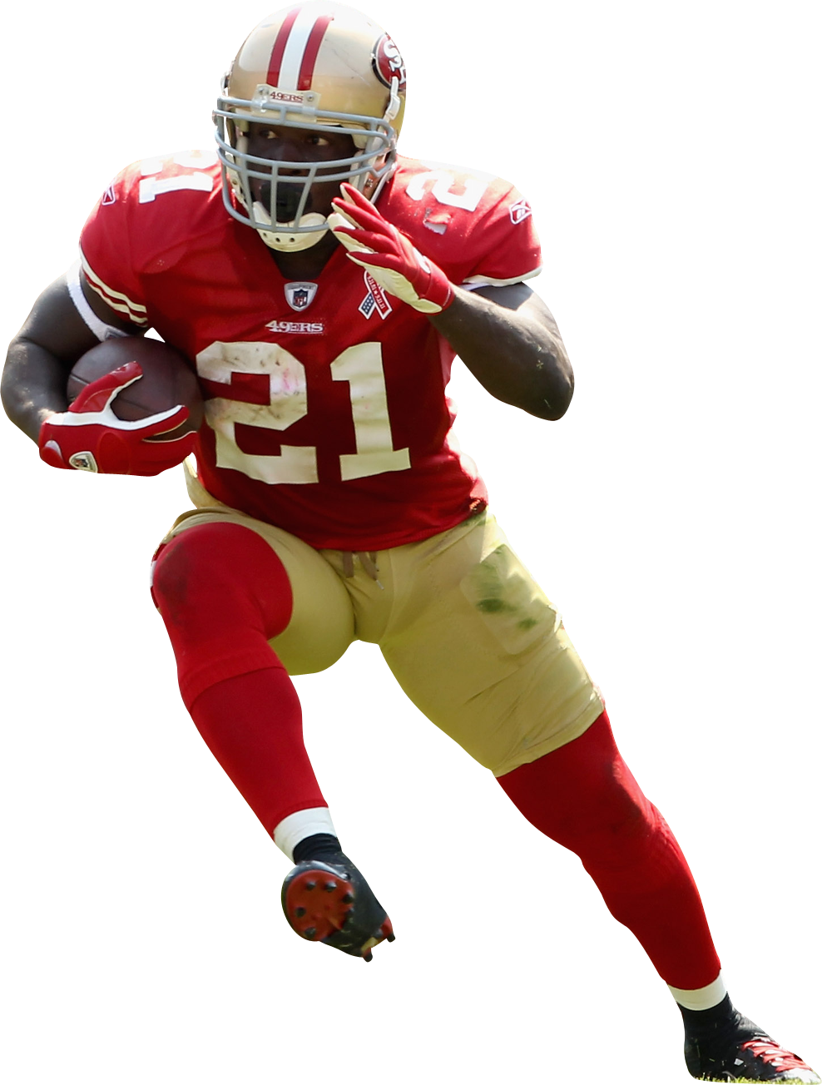
Conclusion
Lessons learned
Results:
The models perform well considering the limited data and lack of traditional evaluative inputs
With additional data (scouting reports, NFL team contracts and position needs, etc.) accuracy could significantly improve
Player assessment: very complex process, there’s no universal method
NFL teams have scouting departments, coaching staff, finance and marketing departments to evaluate performance, personality, team fit and financial aspects
Challenges:
Data gathering, cleaning and processing were very time-consuming
Lots of research done on making the data more informative (feature engineering, normalization)
Many attempts to improve model performance with some surprising results

Slide 37
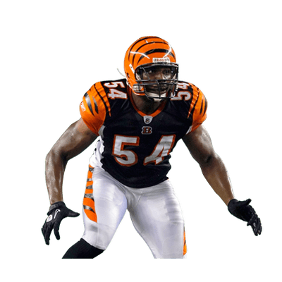
Future research ideas
Predicting NFL Success From College Performance
Approximate Value (AV)
Universal measure for all positions and eras: single value for seasonal performance
(Weighted) Career AV
Expected Draft Value Chart for CarAV
Expected CarAV relative to draft position
If CarAV >= Expected CarAV → Success
Initial attempt
Low model performance (slightly better than random)
Extremely hard to predict success relative to draft pick
Limited data
Notes:
Created by PFR founder Doug Drinen, the Approximate Value (AV) method is an attempt to put a single number on the seasonal value of a player at any position from any year (since 1950).
https://www.sports-reference.com/blog/approximate-value/
Draft value chart:
http://www.footballperspective.com/draft-value-chart/
Extremely hard to predict success relative to draft pick – Take 2 players with identical (or very similar) college numbers. They are drafted as 1/1 and 2/1. Let’s say they perform at the same level in the NFL, one can still be a bust and the other one is a success because expectations are different based on their draft positions.

Slide 38
Thank you!

